Slide 1
The Salvation of the Soul

Slide 2
Salvation of the Soul
1 PETER
“Though now you do not see Him, yet believing, you rejoice with joy inexpressible and full of glory, receiving the end of your faith -- the salvation of your souls.” (1:8-9)

Slide 3
Salvation of the Soul
1 PETER
What is the Salvation of the Soul?
The Salvation of the soul is the triumph of faith in present trials for which glory is received in a future day.

Slide 4
Salvation of the Soul
1 PETER
What is the Salvation of the Soul?
The Salvation of the soul is not the regeneration of the soul, which occurs as a result of faith alone, in Christ alone, which Peter presumes to be a thing of the past.

Slide 5
Salvation of the Soul
1 PETER
What is the Salvation of the Soul?
This Salvation is treated both as a future reality (“ready to be revealed”) and as presently being effected (“though now… receiving the end of your faith”, v. 8-9)

Slide 6
Salvation of the Soul
1 PETER
What is the Salvation of the Soul?
The Salvation of the soul is the total transforming work of God upon our lives, which is presently being realized in the midst of Christ like suffering, and which in the future will be unveiled in Christ like glory.

Slide 7
Salvation of the Soul
1 PETER
What is the Salvation of the Soul?
The Salvation of the soul is the goal our faith, but we are actually in the process presently realizing it through suffering and learning submission.

Slide 8
Salvation of the Soul
1 PETER
Derived from the Teachings of Jesus:
“For whoever desires to save his life “psuche” will lose it, but whoever loses his life “psuche” for My sake and the gospel's will save it.” (Mark 8:35)

Slide 9
Salvation of the Soul
1 PETER
Derived from the Teachings of Jesus:
“For what will it profit a man if he gains the whole world, and loses his own soul? Or what will a man give in exchange for his soul?” (Mark 8:36-37)

Slide 10
Salvation of the Soul
1 PETER
Illustrated in the Parable of the Rich Fool:
Luke 12:13-21
The rich man having saved his soul in this life said, “…I will store all my crops and my good. And I will say to my soul, “psuche” ‘Soul, you have many goods laid up for many years; take your ease; eat, drink, and be merry.’ (12:16-19)

Slide 11
Salvation of the Soul
1 PETER
Illustrated in the Parable of the Rich Fool:
Luke 12:13-21
He who lays up treasure for himself in this life will lose it, but those who lay up treasure in the life to come will save it.

Slide 12
Salvation of the Soul
1 PETER
Illustrated in the Parable of the Rich Fool:
Conversely, the path of self denial, willing subjection and suffering is the way of real preservation, that is, the salvation of the soul.

Slide 13
Salvation of the Soul
1 PETER
What is the Salvation of the Soul?
The Salvation of the soul is gaining the fullness of life by denying ourselves, taking up our cross and following Christ.

Slide 14
Salvation of the Soul
1 PETER
What is the Salvation of the Soul?
“He is no fool to give what he cannot keep to gain what he cannot lose.”
Jim Elliot

Slide 15
Salvation of the Soul
1 PETER
Outline

Slide 16
Salvation of the Soul
1 PETER
Body: Salvation of the Soul, Worked out in Experience – 1:13 – 4:19
In Relation:
to God – 1:13-21
to Brethren – 1:22 – 2:10
to the World – 2:11 – 3:7
to Life Itself – 3:8 – 4:6
to the Consummation of History – 4:7-19

Slide 17
Salvation of the Soul
1 PETER
Body: Salvation of the Soul, Worked out in Experience – 1:13 – 4:19
In Relation:
to God – 1:13-21
Through Obedience – 1:13-16
Through Fear – 1:17-21
Notes:
First Peter describes how the salvation of the soul is worked out in our lives in relationship to God through obedience to God and through fear of God.

Slide 18
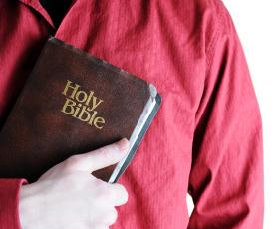
Salvation of the Soul
1 PETER
Body: Salvation of the Soul, Worked out in Experience – 1:13 – 4:19
In Relation:
to the Brethren – 1:22 – 2:10
Through Constant Love – 1:22-25
Notes:
Our current condition is stated in relationship to the brethren in that we have purified our souls, having been born again with an incorruptible seed, [by the means of obeying the truth through the conviction of the Holy Spirit, which is the command of the Father to believe in His Son Jesus Christ, and the will of the Father that whoever believes in Him has everlasting life], for the purpose of sincerely loving the brethren deeply and constantly just like the Word of God that never fades, but eternally endures.

Slide 19
Salvation of the Soul
1 PETER
Body: Salvation of the Soul, Worked out in Experience – 1:13 – 4:19
In Relation:
to the Brethren – 1:22 – 2:10
Through Constant Love – 1:22-25
Through Collective Growth – 2:1-10

Slide 20
Salvation of the Soul
1 PETER
Through Collective Growth – 2:1-10
With a:
Spiritual Appetite for the Pure Milk of the Word – 2:1-3
Understanding of the Magnificence of Our Privilege – 2:4-5
Understanding of the Magnificence of His Person – 2:6-8
Understanding of the Magnificence of Our Purpose – 2:9-10

Slide 21
Salvation of the Soul
1 PETER
In Relation to the Brethren - 1:22 – 2:10
With a Spiritual Appetite for the Pure Milk of the Word – 2:1-3
The desire for God’s Word hinges on our taste of God’s goodness.
Notes:
If love is the true goal of the purified soul – a love which is steadfast and enduring like God’s word, we must first put aside our evil fleshly appetite and all that is inconsistent with it. The salvation of the soul is worked out in relationship to the brethren through collective growth as God’s chosen people with a spiritual appetite of God’s word, an eagerness and longing for the word just as a newborn baby eagerly desires his milk, which has the purpose of bringing us to maturity, to a complete and better understanding of the Word of God, the result being the salvation of the mind and soul.
The desire for God’s Word hinges on our taste of God’s goodness. What follows is a long and extremely rich explanation of that goodness, God’s grace to us collectively, that is, with the Church.
“If we properly desire the Word we must lay aside attitudes of spirit which creates friction and ill will toward the brethren, and we must concentrate on God’s rich grace to us. An assembly filled with malice, envy and strife will not be able to grow properly through the ministry of the Word.” (Hodges, p. 40)

Slide 22
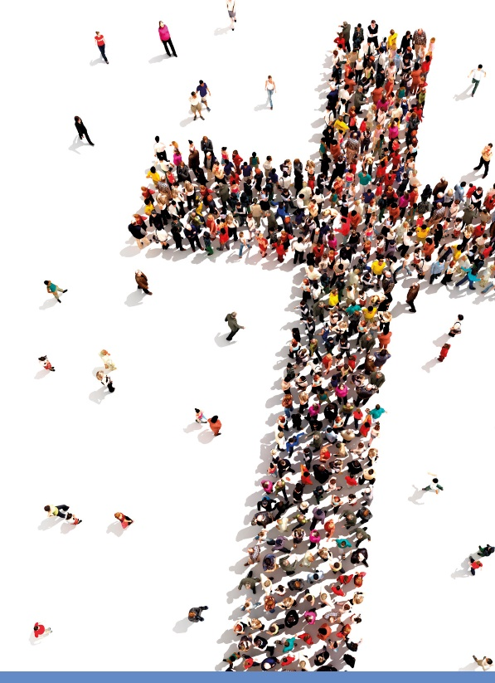
Salvation of the Soul
1 PETER
In Relation to the Brethren - 1:22 – 2:10
With an Understanding of the Magnificence of Our Privilege – 2:4-5
Notes:
The spiritual appetite is whetted by the goodness of the Lord as seen first in the magnificence of our privilege. God dwells in us and we approach Him with acceptable sacrifices, our very lives (2:4-5).
Peter changes the imagery from milk to a spiritual house, a temple in which God dwells. The corner stone chosen by God for this new spiritual house was rejected and cast aside by the men of Israel, judged to be useless and discarded, however it became extremely valuable, having been found to be a perfect fit as the temple’s cornerstone.

Slide 23
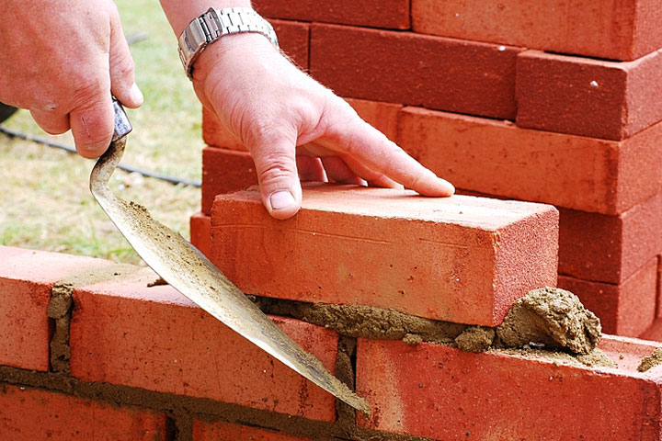
Salvation of the Soul
1 PETER
In Relation to the Brethren - 1:22 – 2:10
“Coming to Him as to a living stone, rejected indeed by men, but chosen by God and precious, you also, as living stones, are being built up a spiritual house, (2:4-5a)
Notes:
When we come to Him, that is, when we believe on Jesus for eternal life, we are added into the spiritual temple as living stones. We have the image of a building which is rising up by the addition of each new stone. When we believed in Him we became a child of God, a member of God’s family, and we become like a living stone, placed into a spiritual house of God.
As persons continue to come to Christ, they become more like Him, conforming to His image, they are continually being “built up” into a spiritual house. The spiritual house grows and the living stones continue to grow when they come to Him.
Paul says that “God’s household is built on the foundation stones of the apostles and prophets, Christ Jesus Himself being the corner stone, in whom the whole building, being fitted together, is growing into a holy temple in the Lord, in whom we also are being “built up” together into dwelling of God in the Spirit” (Eph. 2:19-22)
Believers are identified with Christ for He is the living Stone and we are like living stones. Peter clearly identifies Christ as the Rock upon which He would build His Church (Matt. 16:18)
And Paul calls the church of God which is at Corinth “a temple of God in which the Spirit of God dwells in you” (1 Cor. 3:16)
When Solomon’ constructed the first temple, he asked God to dwell with His people, the nation of Israel. In this temple, God now dwells within His people, His Church.
When we came to Christ we also were baptized by the Holy Spirit and place into the body of Christ, made up of Jews and Gentiles in one body, one new temple. The baptism of the Holy Spirit is the activity that placing the believer into the body of Christ and into His spiritual house.
The building of this spiritual house, the body of Christ began on the day of Pentecost (Acts 2) and the building will come to completion with the catching up of the church. So, currently the building is under construction.
The Church began at Pentecost (Acts 2). It did not exist prior to it. Christ said, not many days from now you will be baptized with the Holy Spirit. (Act 1:5), Christ said, “I will build my Church”, not “I am building my Church.” The church currently resides on the earth but will be removed and gathered to Christ at the rapture, being taken up and escaping the wrath of God that is coming upon the whole earth, know as “the day of the Lord”.

Slide 24
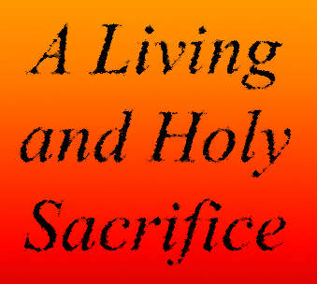
Salvation of the Soul
1 PETER
In Relation to the Brethren - 1:22 – 2:10
“a holy priesthood, to offer up spiritual sacrifices acceptable to God through Jesus Christ.” (2:5b)
Notes:
Believers not only make up the Church, a spiritual house of God, but also serve in it, ministering as a holy priesthood, offering spiritual sacrifices. All believers are priest, a kingdom of priests (Rev. 1:6) continually offering up sacrifices of praise and thanksgiving to His name (Heb. 13:15). Praise to God and doing good to others are our spiritual sacrifices that is pleasing to Him. In addition, “living stones” may also offer themselves a “as living sacrifices, holy, acceptable to God which is your reasonable service” (Rom. 12:1)
Since all believers are priests there is no need for a mediator other than Jesus Christ Himself to approach God directly. There is no hierarchy of priest, no bishops, no popes, no priestly clothing to distinguish ourselves from each other.
Such priestly service requires holiness. In fact we have been purified already positionally (1:16), but practically we are to be as holy, as God is holy (1:22).

Slide 25
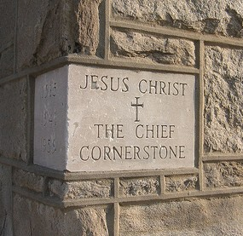
Salvation of the Soul
1 PETER
In Relation to the Brethren - 1:22 – 2:10
With an Understanding of the Magnificence of His Person – 2:6-8
Notes:
Second, the goodness of the Lord is seen in the magnificence of His person. He is God’s elect, a precious and costly Cornerstone in whose honor we share (2:6-8)

Slide 26
Salvation of the Soul
1 PETER
In Relation to the Brethren - 1:22 – 2:10
“Therefore it is also contained in the Scripture, ‘Behold, I lay in Zion a chief cornerstone, elect, precious, and he who believes on Him will by no means be put to shame.” [Isaiah 28:16] (2:6)
Notes:
Peter selects Old Testament support about the stone that was rejected from three passages. He first quotes Isaiah 28:16.
In its original context the foolish leadership in Jerusalem had rejected the LORD and His plans and were make plans of their own built on sand. Isaiah tells them that they needed a more secure foundation in order to withstand the storms of life. Only faith in the LORD can do that. Their carefully laid plans, treaties with Assyria or Egypt will come to nothing. They even tried to make a covenant with death (28:14,18)
In verse 16, it is here because the rules’ boast that they have secured themselves against trouble that the word of the Sovereign of the universe comes to them. They now face the absolute monarch.
The message is a double-edged one. “God is establishing a structure in Zion, which will be a source of comfort and encouragement to those who will trust Him but a bar of judgement for those who refuse to do so. The imagery of laying a foundation for a building is used to make the point”. (Oswalt, 517-518)
The leaders laid a foundation with cheap stones, poorly laid. It was not going to be possible for their building to withstand the shocks that will come against it. They had rested all there faith and hope, the nations survival on the promises of idolatrous rules of their neighbors. By contrast God was also laying a foundation of His own in whom one can fully trust.
The nation of Israel is built on Him, but not just yet.
“The cornerstone is the primary foundation-stone at the angle of the structure by which the architect fixes the standard for the bearings of the walls and cross-walls throughout.” (Moulton and Milligan, Vocabulary, p. 19.) It is where the building places it strength and stability.
Believers of all ages can trust the LORD much as the building rest on its cornerstone. They will never be a shamed or disappointed. The Greek has a double negative, “never indeed will you be shamed.” We have a scriptural promise of ultimate victory for those who trust Christ.
The Church is also built on Christ, God’s great Cornerstone. “By Him, God measures all things and fixes the ultimate standard for all who come to Him.” (Hodges, p. 41) He is chosen and precious.
“The Church is distinct from Zion (Jerusalem) even though it Foundation Stone, Jesus Christ, was laid there.”

Slide 27
Salvation of the Soul
1 PETER
In Relation to the Brethren - 1:22 – 2:10
“Therefore, to you who believe, He is precious; but to those who are disobedient,
‘The stone which the builders rejected has become the chief cornerstone, [Psalm 118:22] and ‘A stone of stumbling and a rock of offense.’ [Isaiah 8:14] (2:7-8a)
Notes:
The promise that God can be fully trusted in Isaiah is explained by Peter’s quotation in Psalm 118:22, His readers. “to you who believe” to anyone who believes finds Jesus precious, of ultimate value, as the chief cornerstone of the spiritual temple and service we participate in.
But we see a sharp contrast between those who believe and those who do not.
Those who do not believe are described as “those who are disobedient,” To disobey the message, “the gospel of God” (4:17) is to reject it ; and to obey it is to believe it; it is in “obedience to the truth” (1:22), it is “the will of the Father”. And it is in “obedience to the faith” (Acts 6:7).
Those who refuse to believe, reject Christ, the Stone and stumble over Him because of their disobedience. This happen to the leaders of Jerusalem in Isaiah’s day and it happen again to the chief priest and Pharisees when Jesus quoted Psalm 118:22 to them in Matthew 21:42.

Slide 28
Salvation of the Soul
1 PETER
In Relation to the Brethren - 1:22 – 2:10
“They stumble, being disobedient to the word, to which they also were appointed.” (2:8b)
Notes:
Their stumbling does not refer to their failing to believe, but to the consequences of their choice to not believe. As a result of not believing and being disobedient to the Word they stumble.
The verb “being disobedient” includes the idea of a willful refusal to believe. It is not that they are not able to believe, it is that they will not believe, a conscious willful rejection.
Because of the sin of disobedience, all disobedient unbelievers are appointed for “stumbling” which leads to punishment, both temporal and eternal. For the Jewish leader temporal punishment came in 486 BC and in 70 AD and they are still experiencing eternal punishment.

Slide 29
Salvation of the Soul
1 PETER
In Relation to the Brethren - 1:22 – 2:10
With an Understanding of the Magnificence of Our Purpose – 2:9-10
Notes:
Finally, the goodness of the Lord is seen in the magnificence of our purpose. Since we are set apart by God for a special purpose as a unique people, we are to show forth Christ’s praises or excellences.

Slide 30
Salvation of the Soul
1 PETER
In Relation to the Brethren - 1:22 – 2:10
“But you are a chosen generation, a royal priesthood, a holy nation, His own special people, that you may proclaim the praises of Him who called you out of darkness into His marvelous light;” (2:9)
Notes:
Peter now contrasts his readers and us “but you” with the disobedient nation of Israel. To all who believe and obey the truth are appointed to a better experience. Peter describes this new experience with four terms. He uses terminology originally applied to Israel (Ex. 19:5; Deut. 7:6; Isaiah 43:20) he now applies it to the Church.
“The description does not create an identity between Israel and the Church, for similarity does not prove identity.
“chosen generation” – emphasizes God’s purpose and action including His plans.
“a royal priesthood” – this is a priesthood after the order of Melchizedek.
“a holy nation” – Peter is not saying Israel has been abandon by God. We learned in Isaiah that because Israel had forsaken the LORD, He had forsaken them, but that forsaken was not forever. Peter is emphasizing the Church’s distinction, its holiness and set apartness from the nations of the world.
“his own special people” – the church is like Israel because we belong to God.
“While these descriptions of the church are similar to those used of Israel in the OT, this is no way indicates that the church supplants or replaces Israel and assumes the national blessings promised to Israel numerous times even after they continually rebelled against the LORD. Peter just used similar terms to point out similar truths. Israel was a chosen generation, a nation of priests, a holy nation, a people belong to God, and one day shall be that again, so too believers today a chosen, all are priests, holy saints, belonging to God. Similarity does not mean identity.

Slide 31
Salvation of the Soul
1 PETER
In Relation to the Brethren - 1:22 – 2:10
“Therefore I say to you, the kingdom of God will be taken from you and given to a nation bearing the fruits of it.” (Matthew 21:42)
Notes:
Some quote Matt. 21:42 “Therefore I say to you, the kingdom of God will be taken from you and given to a nation bearing the fruits of it.” as proof that the kingdom was taken away from the Jews and was given to Gentiles. They however, wrongly connect the dots. Jesus meant that the kingdom is being taken away from that rejecting, unbelieving generation and will be given to another generation of Jews who will believe.
Some say that the church has become “spiritual Israel”. The bible never says that. The bible never says that there are Israelite or Jews who are outside the nation of Israel. Romans 9:6-8 only says that not everyone who is a physical descendent of Abraham is a true Israelite. In other words, a true Israelite is not only a physical descent of Abraham, but is also a spiritual descent of Abraham by faith. Gentiles can never be considered a true Israelite of Jew.
Paul says in Gal 3:29), ”if you are Christ's, then you are Abraham's seed, and heirs according to the promise.” We are Abraham’s offspring by faith, and gentiles share in the blessing, not in the land or the national promise.

Slide 32
Salvation of the Soul
1 PETER
In Relation to the Brethren - 1:22 – 2:10
“But you are a chosen generation, a royal priesthood, a holy nation, His own special people, that you may proclaim the praises of Him who called you out of darkness into His marvelous light;” (2:9)
Notes:
God’s purpose in choosing believers for Himself is so that we might declare the praises of Him. These are the qualities or excellences of God. Our praises and worship
“you” do this in contrast to the disbelieving who stumble. The greatness of our privileges see here is best seen in light of the fate of others. The goodness that you have tasted (2:3) includes the fact that God has chosen you, He has privileged us as royal priests, and sanctified us a holy nation and have become God’s own possession.
Our praises and worship of God is the proper response to the great mercy that we have received and “has caused us to be born again to a living hope…” (1:3) and has transferred us from the kingdom of darkness into God’s light.

Slide 33
Salvation of the Soul
1 PETER
In Relation to the Brethren - 1:22 – 2:10
“who once were not a people but are now the people of God, who had not obtained mercy but now have obtained mercy.” (2:10)
Notes:
This may be a reference to Hos 1:10, “In the place where it was said to them, 'You are not My people,' There it shall be said to them, 'You are sons of the living God.” The LORD said to Israel that their status will be changed from being rejected to being His sons, my people, once again. Paul state that this promise is still in effect and will be kept in the future (Rom. 9) Gentiles believers are like Israel in that they too were once not God’s people but have now become God’s people, having a special status in the administration or dispensation of God’s purposes on the earth. The Jewish believers in Peter’s audience are the righteous remnant spoken of in the OT prophets.

Slide 34
Salvation of the Soul
1 PETER
In Relation to the Brethren - 1:22 – 2:10
The Nation of Israel
The Church
“my people”
“not my people”
“not my people”
“my people”
“God only works with one group of people at a time.”
C. Norman Sellers
“my people”

Slide 35
Salvation of the Soul
1 PETER
Conclusion

